Slide 1
CAPSTONE PROJECT

Slide 2
AI smart finance assistant

Slide 3
The Team no.9
Faiza
Kanak
Taniya Team Leader
Alisha
Student Name

Slide 4
Workload Division
Contribution of each team member in project
Taniya Dhingiya = PPT
Faiza = Coding
Alisha = Report
Kanak = Video Editing

Slide 5

PROJECT THEME
Finance
This project belongs to the finance domain and focuses on simplifying financial management using Artificial Intelligence.

Slide 6
Problem Statement
Many people find finance confusing and difficult to manage.
They struggle with:
* Understanding income and expenses
* Planning budgets
* Saving money
* Making basic financial decisions
Because of this, people often make poor financial choices or avoid financial planning altogether. There is a need for a *simple, intelligent system* that can guide users in an easy and friendly way.

Slide 7
Project overview
*AI Smart Finance Assistant* is a finance-based project that uses *Generative Artificial Intelligence* to help people understand and manage their finances easily.
The system interacts with users in *simple English*, analyses their financial data, and provides:
* Easy explanations
* Smart suggestions
* Personalized financial guidance
The goal of this project is to *remove fear and confusion from finance* and make financial management easy for everyone.

Slide 8
Objectives of the project
The main objectives are:
1. To simplify complex financial concepts
2. To help users manage income and expenses
3. To provide smart budgeting and saving suggestions
4. To use AI for personalized financial guidance
5. To improve financial awareness and decision-making

Slide 9
Scope of the project
This project focuses on:
* Personal finance management
* Monthly income and expense tracking
* Budget planning
* Saving recommendations
* Financial advice using AI
It is suitable for:
* Students
* Working professionals
* Small business owners
* Beginners in finance

Slide 10

Technologies used
*Python* – Core programming language
*Jupyter Notebook* – Development and analysis
*MySQL* – Storing user financial data
*Generative AI* – Providing intelligent responses and suggestions

Slide 11
System features
The AI Smart Finance Assistant provides the following features:
* User income and expense input
* Automatic expense categorization
* Monthly budget creation
* Saving tips and alerts
* Simple financial explanations
* AI-based financial advice

Slide 12
Advantages of the project & future enhancements
Advantages of the project
* Easy to use
* User-friendly language
* Saves time
* Reduces financial confusion
* Helps improve money management habits
future enhancements
In the future, this project can include:
* Mobile application
* Voice-based assistant
* Investment guidance
* Bill reminders
* Bank API integration

Slide 13
Working of the system
1. User enters income and expense details
2. Data is stored in the database
3. AI analyses the data
4. System generates:
* Budget summary
* Spending analysis
* Saving suggestions
5. User receives easy and understandable guidance

Slide 14
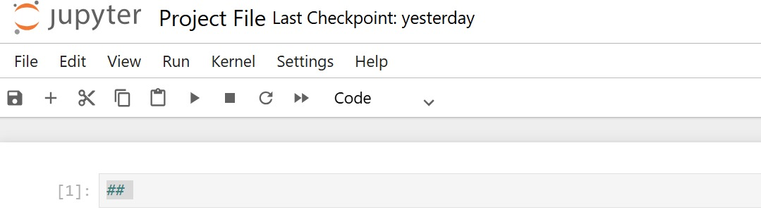
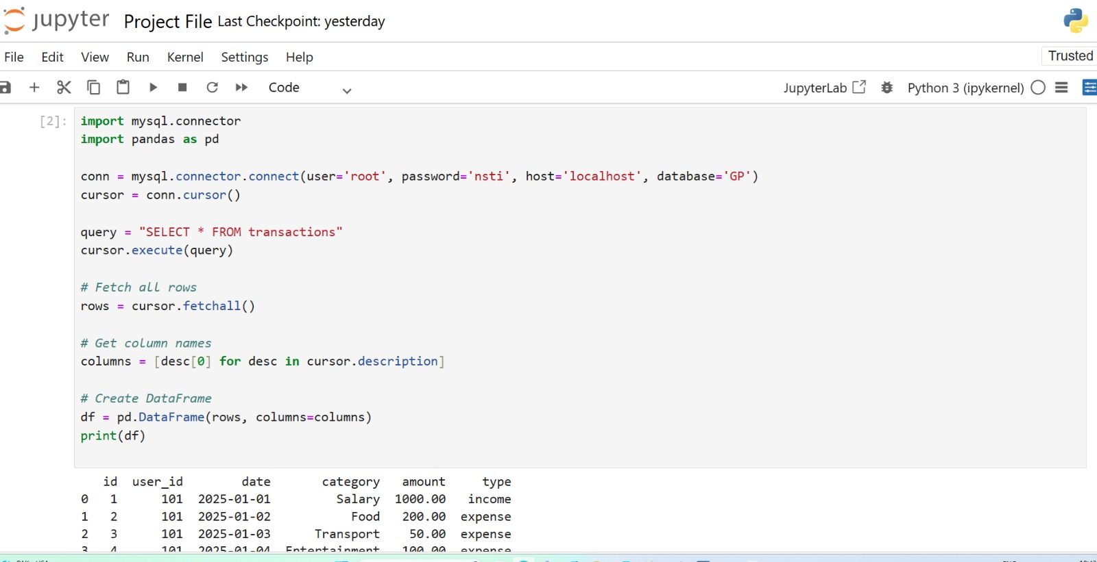
coding

Slide 15
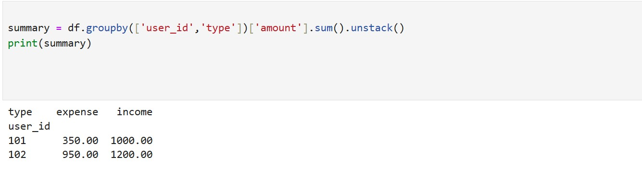

Slide 16
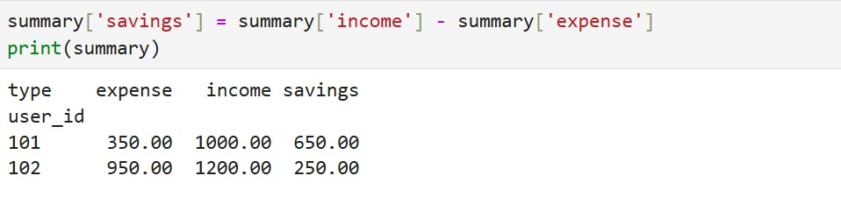
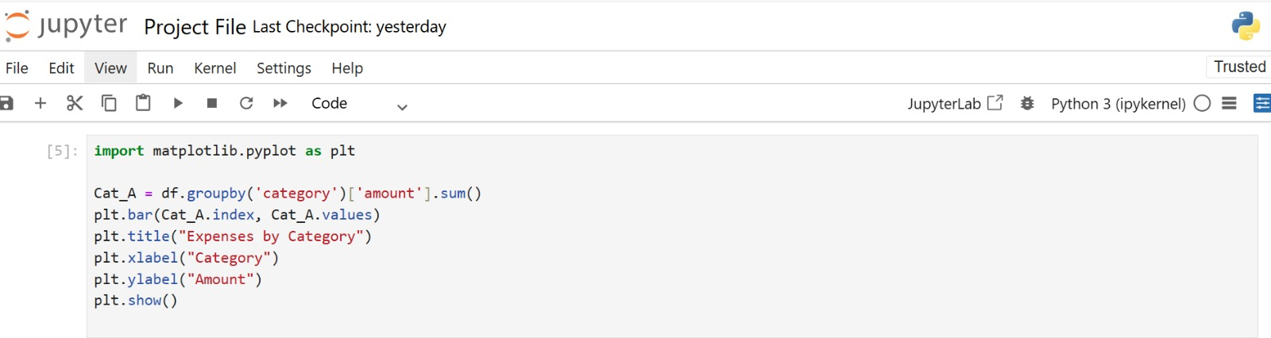
Steps

Slide 17

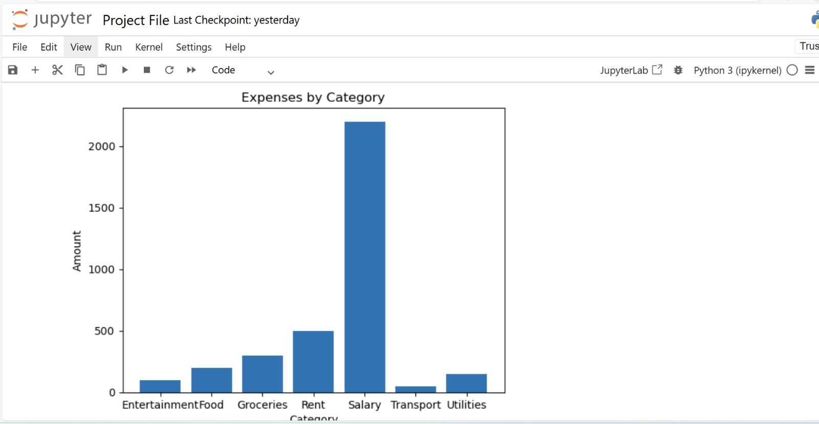
graph

Slide 18

Conclusion
The *AI Smart Finance Assistant* is a powerful and simple solution for people who find finance difficult. By using Generative AI, the project makes financial management easy, interactive, and understandable. This system helps users make better financial decisions and develop healthy money habits.

Slide 19
Thank You

